Slide 1
AirNet Company Network Design & Security
Computer Networks Project
Using VLSM, VLANs, VPN & Security Controls
Group Members
Ali Raza (243749)
Waseem Abbas (243742)
M. Anas Akram (243766)
Mohsin Abbas (243743)

Slide 2
Introduction
AirNet Company is a growing Australian enterprise
Head Office in Sydney with international branches
Requires secure, scalable, and efficient networking
Design focuses on security, performance, and future growth

Slide 3
Business & User Requirements
Sydney HQ: 5000 users
Melbourne: 3200 users
Brisbane: 2500 users
Hong Kong: 2785 users
Reliable inter-branch communication required

Slide 4
Networking Requirements
Private IPv4 block: 188.42.0.0/16
Secure Firewall connectivity between branches
Centralized services at Sydney HQ
VLAN-based departmental separating
Secure wired and wireless access

Slide 5
Network Topology Selection
Hierarchical Star Topology selected
Widely used in enterprise environments
Easy scalability
Cost-effective and centrally managed

Slide 6

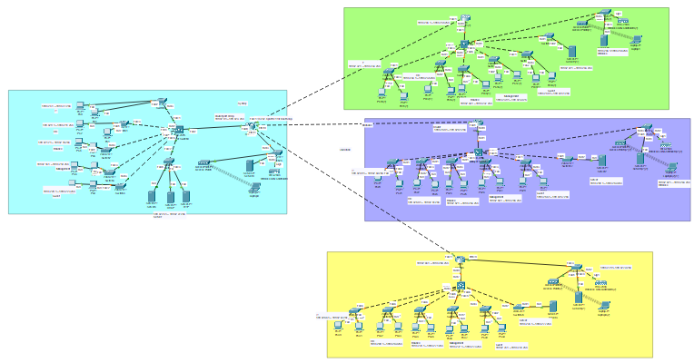
Topology Architecture

Slide 7
LAN Design Overview
Each building has 8 floors
Access switches on every floor
Distribution layer uses Layer 3 switches(Multi-layer switch)
Dedicated server room on Level 5
Firewall placed between LAN and Internet

Slide 8
IP Addressing & VLSM
Base network: 188.42.0.0/16
VLSM used to avoid IP wastage
Subnets allocated from largest to smallest
Supports current users and future expansion

Slide 9
Subnet Allocation Summary
Sydney HQ: 188.42.0.0/19 (8190 hosts)
Melbourne: 188.42.32.0/20 (4094 hosts)
Hong Kong: 188.42.48.0/20 (4094 hosts)
Brisbane: 188.42.64.0/21 (2046 hosts)
Efficient and justified allocation
Location | Network Address | CIDR | Subnet Mask | Usable IP Range
Sydney HQ | 188.42.0.0 | /19 | 255.255.224.0 | 188.42.0.1 – 188.42.31.254
Melbourne | 188.42.32.0 | /20 | 255.255.240.0 | 188.42.32.1 – 188.42.47.254
Hong Kong | 188.42.48.0 | /20 | 255.255.240.0 | 188.42.48.1 – 188.42.63.254
Brisbane | 188.42.64.0 | /21 | 255.255.248.0 | 188.42.64.1 – 188.42.71.254

Slide 10
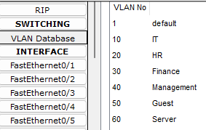
VLAN Design & Segmentation
VLAN 10 – Management
VLAN 20 – Human Resources
VLAN 30 – Finance
VLAN 40 – IT Support
VLAN 50 – Guest Network
VLAN 60 – Server VLAN (Level 5)

Slide 11
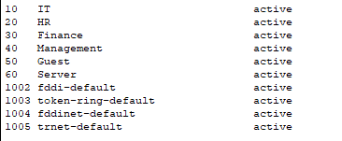
Inter-VLAN Routing & Server Security
Inter-VLAN routing via Layer 3 switches
Server VLAN isolated for security
Only authorized VLANs allowed server access

Slide 12
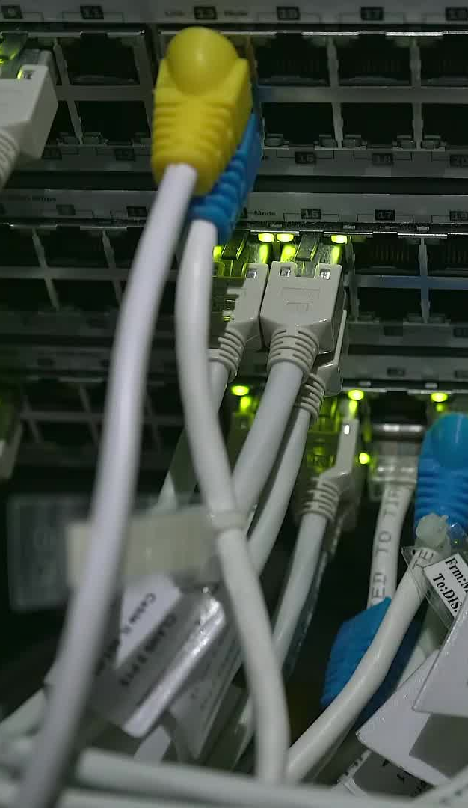
Hardware Selection & Wireless Network
Wireless networks can be easily expanded without the need for additional wires.
Layer 3 switches for high-speed routing
Layer 2 switches for access layer connectivity
Cat6 cabling for high performance

Slide 13
Conclusion
Secure and scalable enterprise network designed
Efficient IP utilization using VLSM
Strong security using VLAN and firewalls
Design supports future business growth

Slide 14
Thank You

